Slide 1
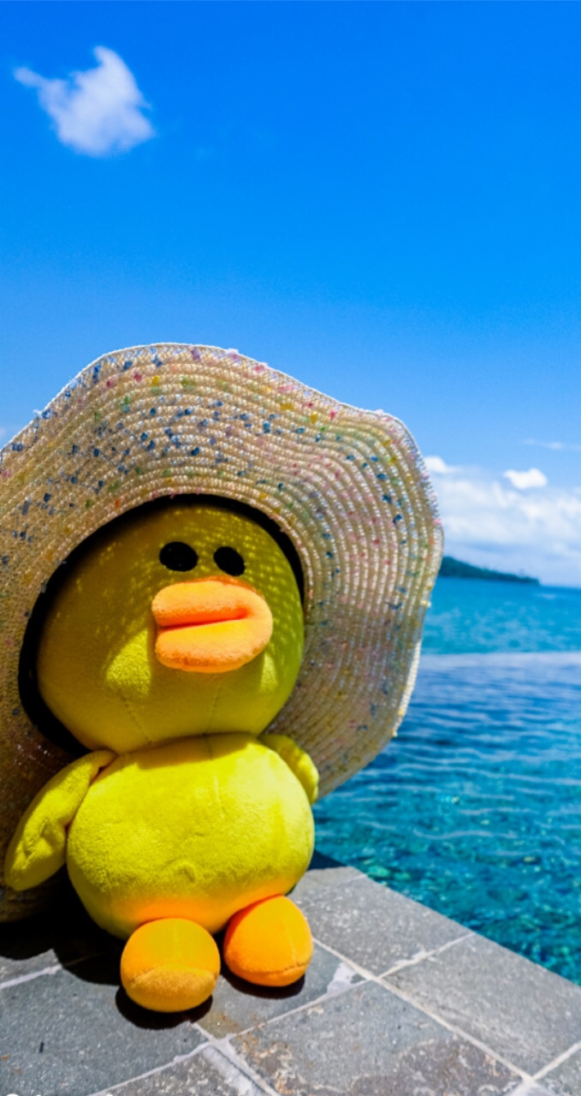
LUCKY O/X

Slide 2

X = Sit down
O = Stay
standing
The last student standing is the winner!!

Slide 3
Can I ride a bike?
O
Can I try this?
O
X
O
Can I sit here?
Can I use this crayon?
O
O
Can I take a picture?
Can I touch it?
X
O
Can I come in?
Sorry, you can't.
O
X
Can I have some tteok?
Yes, you can.

Slide 4
X
Grandpa, what's this?
Look at that! That's nice!
O
O
X
Yes, you can.
Wow! This picture is beautiful.
O
O
This is TTB3. It's a bike for time trips.
Yes, you can. Don't push that button!
X
O
Is this a new bike?
Can I draw a picture?
X
O
Let's go there.
Yes, it is.

Slide 5
O
Sorry, you can't.
Can I come in?
O
O
X
Time trips? Can I ride the bike?
Goodbye!
O
O
Oh, no!
Thank you.
X
X
Can I have some cookies?
Can I use this pencil?
X
O
Can I get a map?
Can I fly a drone?

Slide 6
Can I have some tteok?
O
Can I try this?
O
O
O
Can I sit here?
Sorry, you can't.
X
X
Yes, you can.
Sure. Here you are.
X
O
He's jumping on the rope.
Of course. Say, "Gimchi!"
O
X
Can I take a picture with you?
Can we join you?

Slide 7
Please come in.
O
The painting is moving.
O
X
O
Can I get a map?
Can I touch it?
O
O
Yes, you can. Here you are.
It's really beautiful.
X
X
Sorry, you can't.
You can draw some pictures here.
O
X
Oh, I see.
Let's go over there!

